Slide 1
BANK TELEMARKETING CAMPAIGN
A Project to fulfill the Graded Assignment of Python

Slide 2
Problem Statement
To enhance the revenue of Bank by conducting a cost-efficient telemarketing campaign for term deposits among existing customers.

Slide 3
Objective
The objective of this project is to conduct an end-to-end Exploratory Data Analysis (EDA) on the campaign dataset, identifying patterns and providing insights to improve the positive response rate.
The analysis involves examining customer demographics, temporal trends, and other factors influencing the success of the campaign, ultimately offering recommendations for targeted improvements in the bank's marketing strategy.

Slide 4
Software/Tools
Jupyter Notebook (Python)
Python
Numpy
Matplotlib
Seaborn
ScipyStats

Slide 5
Data Description
The given dataset includes the age, salary, balance, marital status, job, education, loan type, loan status, contact period, previous contact details & outcomes and recent responses of the customers of the bank.

Slide 6
Details of Data Analysis

Slide 7
1. Understanding the Dataset
In this part, the data has been loaded into the Jupyter file and inspection has been done to clean the data, missing values and outliers has been handled using suitable codes & libraries like missingno, seaborn etc. The titles of the columns (or also called as headers) has also been changed using iloc and reset.Datatype of Duration column has been modified as a new column TIME.

Slide 8
2. Descriptive Statistics
Summary statistics have been derived using describe on the relevant columns like age, salary, balance, campaign etc. The distribution of the target variable, indicating responses to the term deposit campaign has been examined which represents that out of the targeted customers of the campaign, the percentage of people responded to Yes.

Slide 9
3. Univariate Analysis
The distribution of individual key features like age, balance, call duration etc. has been examined using histogram, density plot and boxplot.

Slide 10
4. Bivariate Analysis
Independent variables such as age, salary and Time has been taken with respect to Targeted. At first, jobedu column has been split into two columns, Job and Education. After that the analysis of Salary, Age and Time has been done using boxplot and violin plots. The salary vs targeted plot showed that the people with less salary has responded yes but the difference between both the responses is small. For age and time, the response is almost same.

Slide 11
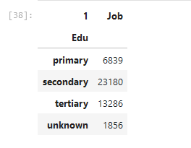
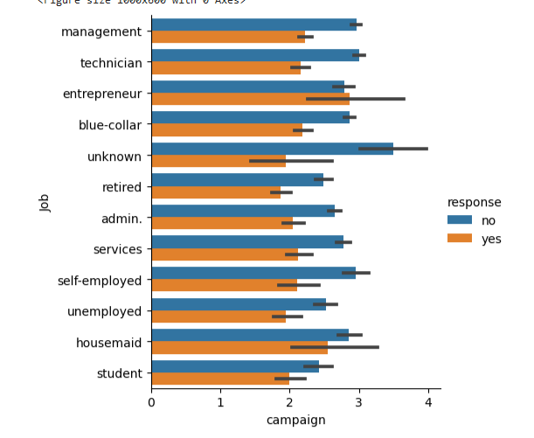
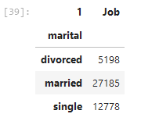
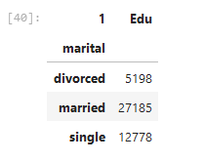
The categorical variable like job, marital and education has been analysed and picture 38, 39 and 40 clearly define the results. The visual representation of impact of categorical variables on campaign can be seen in the pictures below-
5. Categorical Variables Analysis

Slide 12
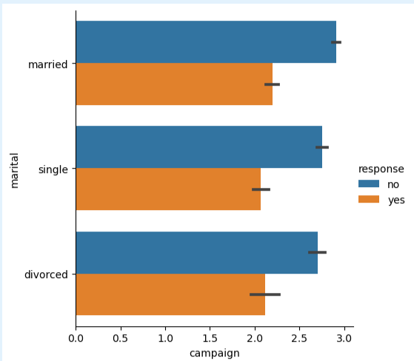
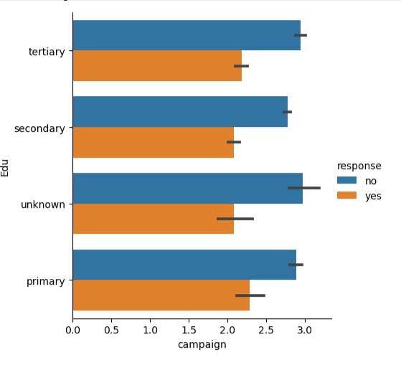
5. (continued)

Slide 13
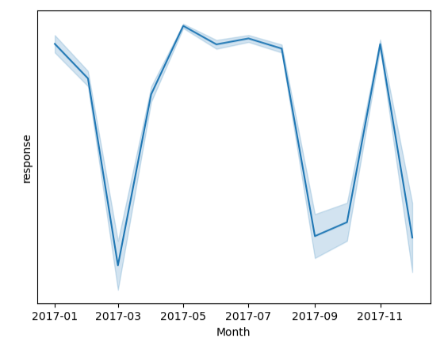
6. Temporal Analysis
To investigate the Temporal patterns, a new column Month was made with date type of datetime. It represented that May has the highest number of positive responses followed June, July and November. The count of the responses can be seen in the ipynb file.

Slide 14
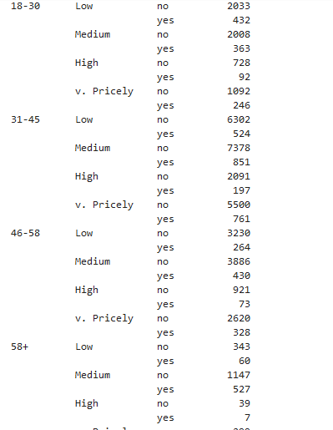
7. Feature Engineering
A new column for age groups has been made. Age and Salary have been divided into 4 individual groups. The responses for all can be seen in the picture. Focus is required on High and Very Pricely groups of all age groups.

Slide 15
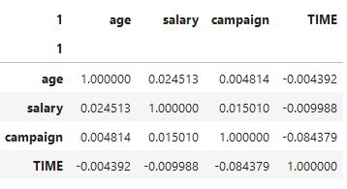
8. Correlation Analysis
The correlation between independent variables is as-
For evaluation of correlated features influencing target variable can be seen in ipynb.

Slide 16
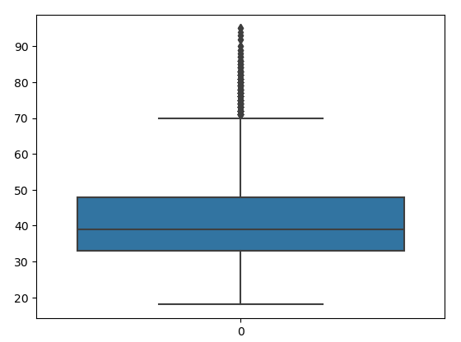
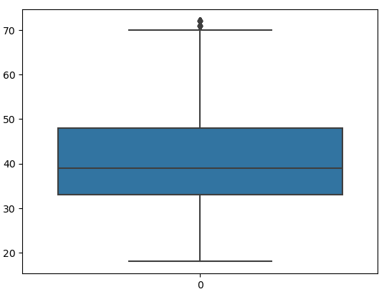
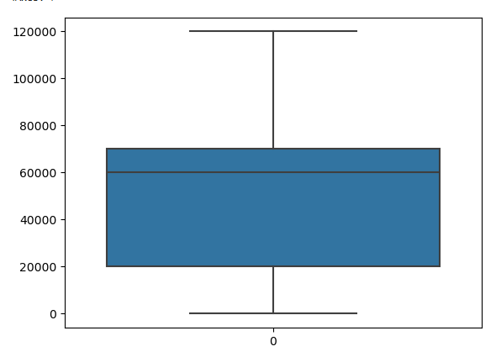

9. Outlier Detection and Handling
As the SKEWNESS of SALARY is 0.1377, which is lying between -0.5 to 0.5, shows that it is Approximately Symmetric.
1 Age
2 Salary
On Left- Outliers
On Right- Results after removing Outliers

Slide 17
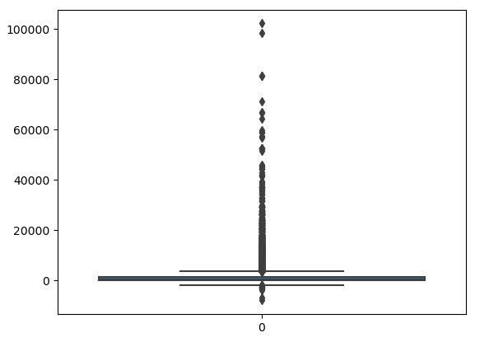
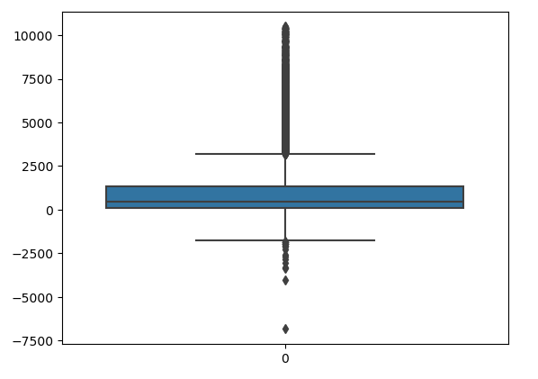
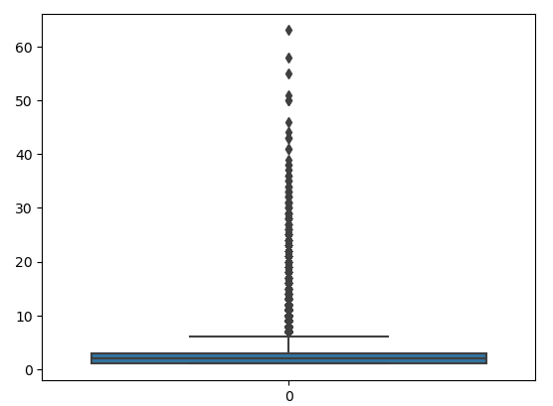
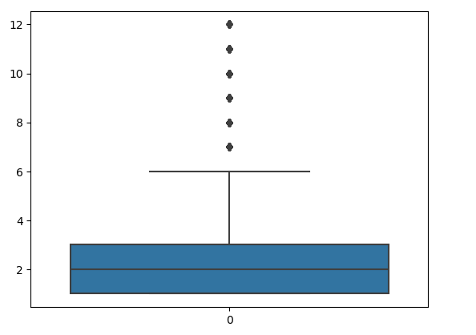
9. (Continued…)
1 Balance
2 Campaign
On Left- Outliers
On Right- Results after removing Outliers

Slide 18
By- Vattandeep Kaur ABADS, Batch - 12
Thank You

